Slide 1
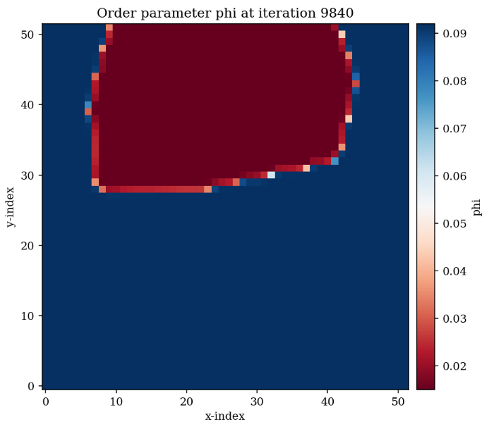
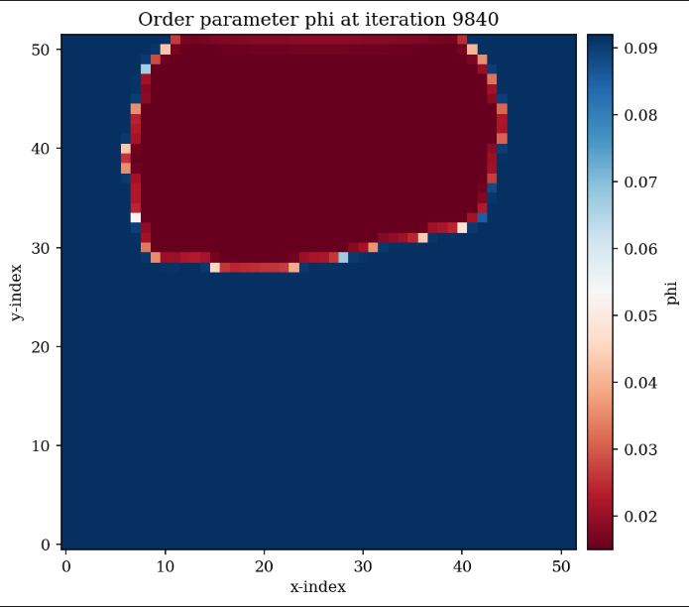
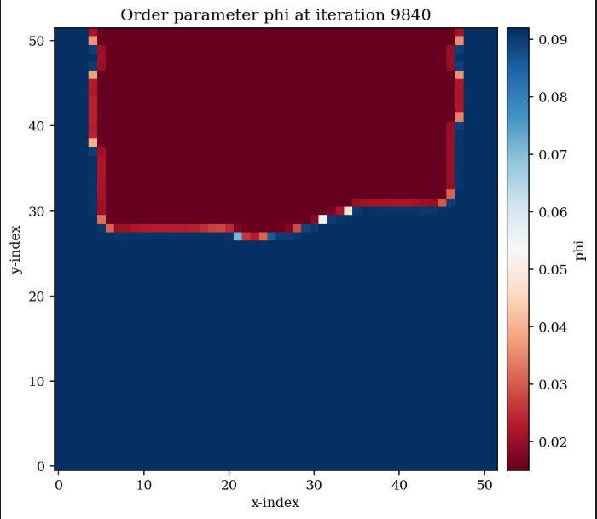
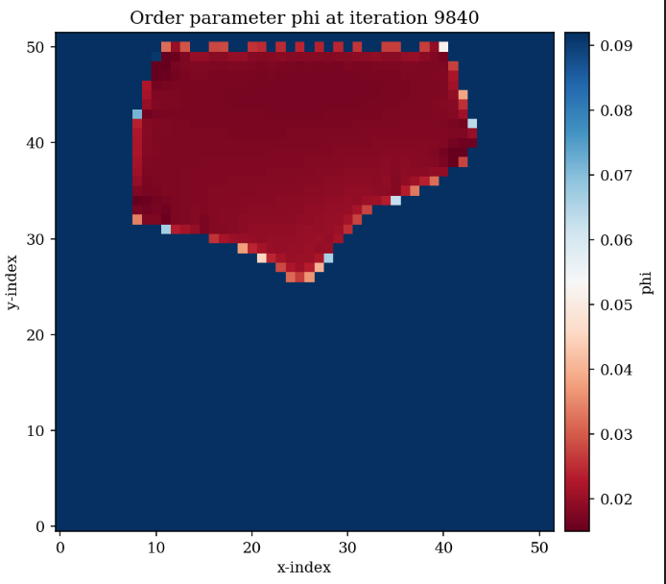
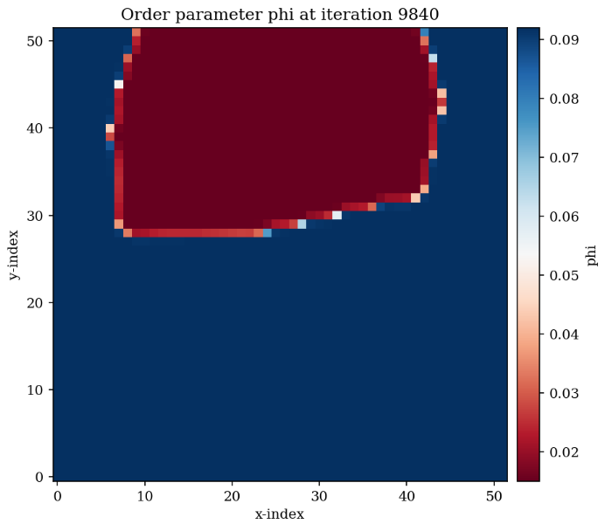

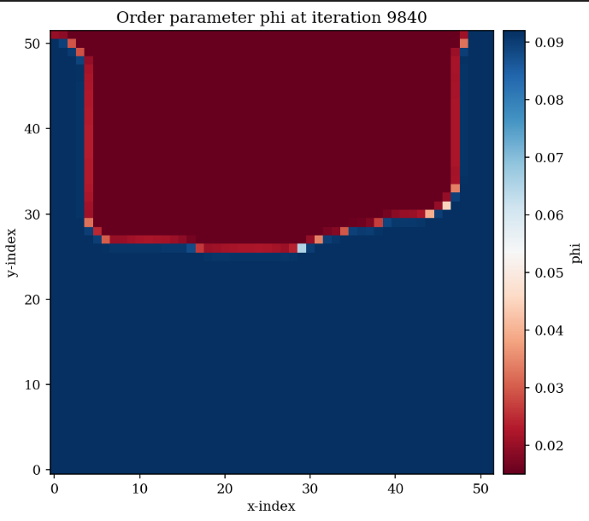
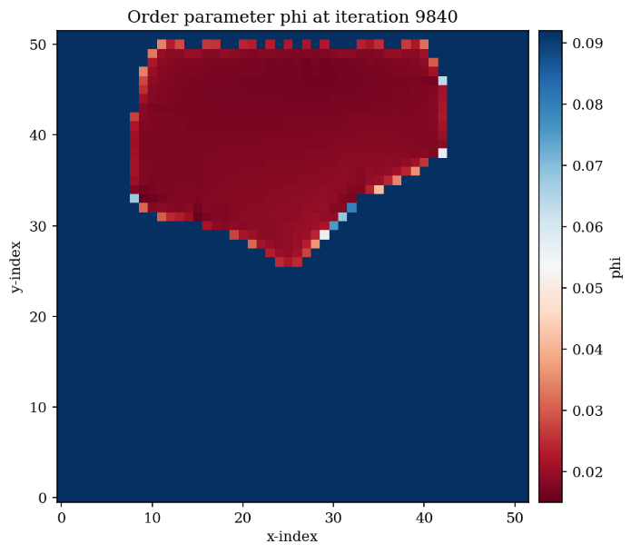
sigma=0.3, vf_theta = 0
sigma=0.3, vf_theta = 40
sigma=0.3, vf_theta = 85
sigma=0.2, vf_theta = 60
sigma=0.3, vf_theta = 20
sigma=0.3, vf_theta = 60
sigma=0.3, vf_theta = 89
sigma=0, vf_theta = 60

Slide 2
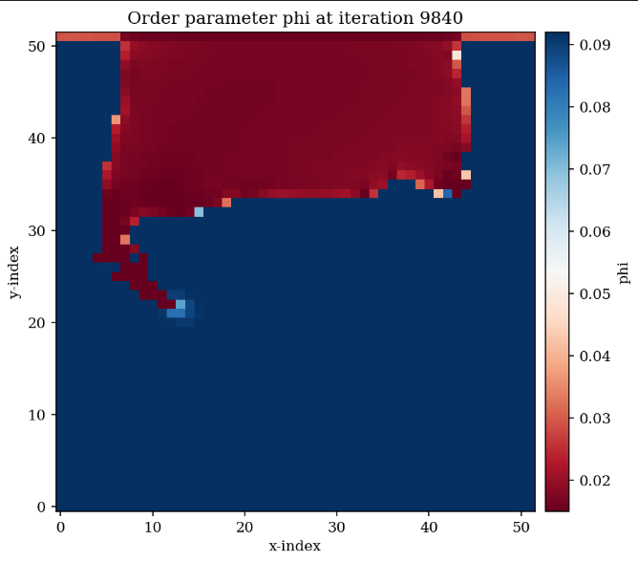
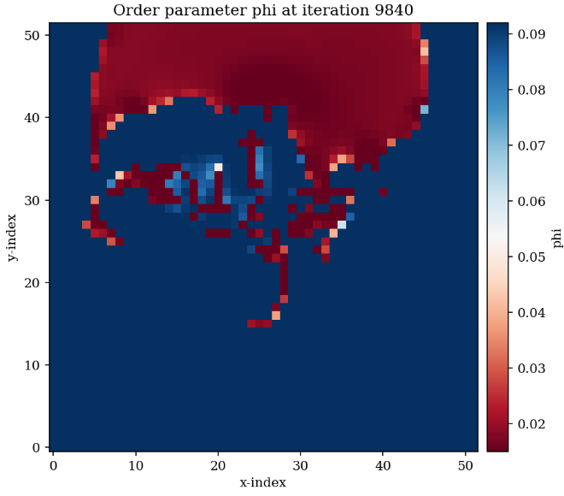
Top-Dirichlet: _phi[:,Yn]┬= phi_star_G
Top: _phi[:, Yn+1] = _phi[:, Yn]

Slide 3
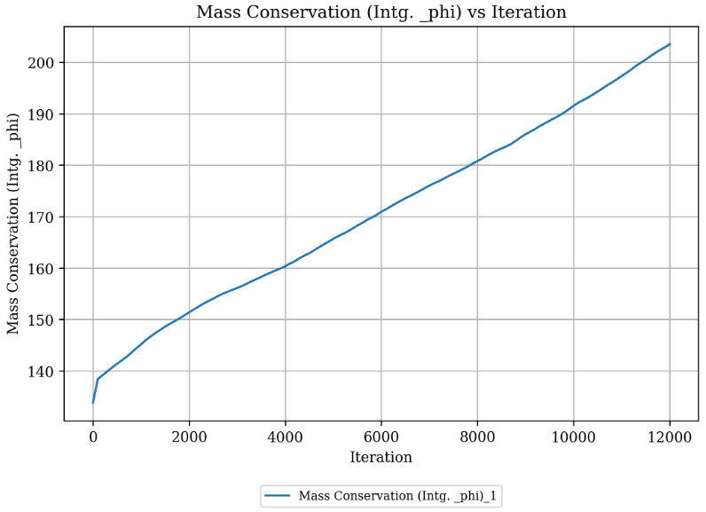

Slide 4
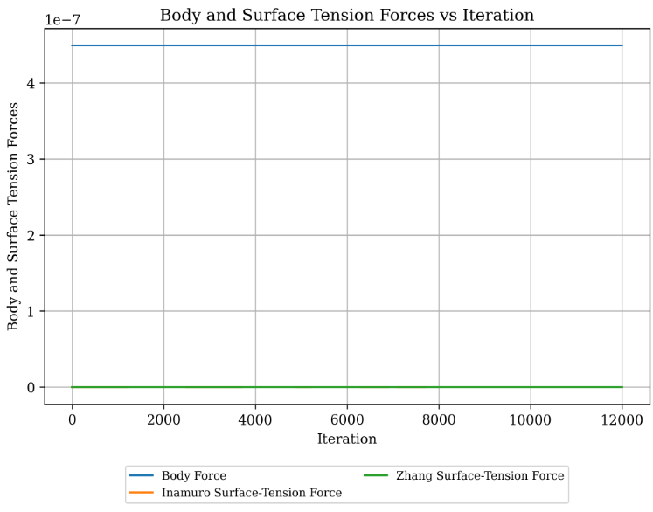


Slide 5

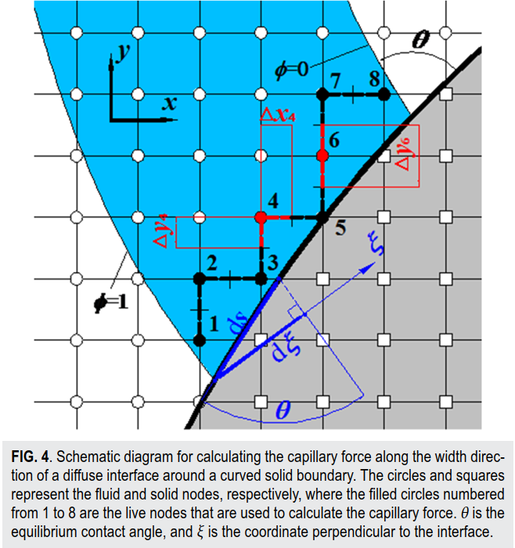







Slide 6

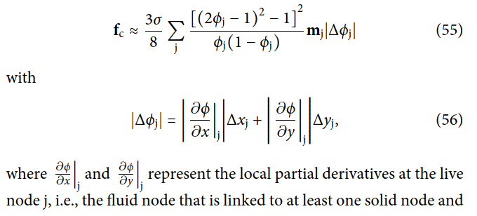

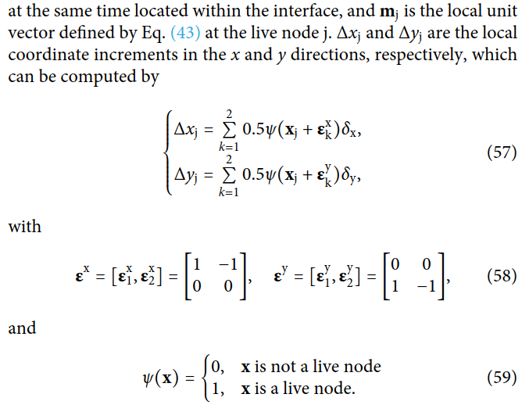
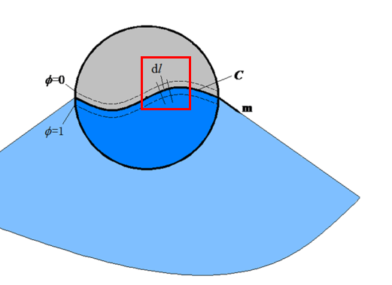
m
1

